Slide 1
2023 IHE-Europe Connectathon What’s new in IT-Infrastructure?
Wei Jing TEY
Deputy Test Session manager

Slide 2

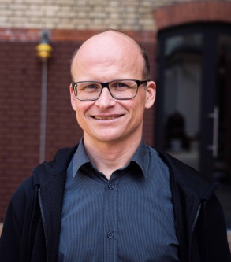
Speakers:
John Moehrke
Architect: Healthcare Informatics Standards - Interoperability, Privacy, and Security IHE Co-Chair IT Infrastructure Planning and Technical HL7 Co-Chair Security WG, FHIR FMG, FHIR facilitator, and FHIR Foundation founding member
Oliver Egger
eHealth Architect Founder of ahdis.ag IHE International ITI Technical Commitee Co-Chair IHE Suisse member HL7.ch member

Slide 3

2023 IHE-Europe Connectathon Week
The IHE Connectathon will take place 25-29 September 2023 in Rennes, France

Slide 4
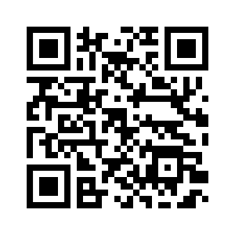






How to register to the event?
01
Log into Gazelle Test Management
Create your account if it is your first time with Gazelle: how-to
02
What do you want to test?
Register your systems under test: how-to
03
Who will attend in Rennes ?
Register the people who will attend the event in Rennes.
In case you are still unsure of the names of the attendees, you still have until end of June to perform changes
04
Generate Contract
Check the relevant boxes in the first section of the document
Add your name where asked
Send the form to office@ihe-europe.net and technical.manager@ihe-europe.net
05
Invoicing
An invoice will be sent to your billing contact
06
You are ready to start testing
Upon receipt of the payment on IHE-Europe’s bank account, the Connectathon technical manager will accept your system in the tool
ONLY ACCEPTED SUT CAN SEE THEIR TEST PLAN

Slide 5

Be an Early Bird
How ?
End on 30th March 2023
Register your system
Update the register status of your system to "Completed".
Generate the contract.
send it to office@ihe-europe.net and technical.manager@ihe-europe.net by 30th March 2023
20% off on your registered system

Slide 6
Agenda
Introduction of the IT-Infrastructure domain: what does it cover in terms of business cases
What is new since September?
What will happen until the Summer (and in scope for the Connectathon in September)
Focus on hot profiles
Q&A session

Slide 7
IT-Infrastructure
The IT Infrastructure Domain defines interoperable infrastructure for the secure sharing of healthcare information independent of clinical domain. Interoperable infrastructure is necessary to support common IT functions for a variety of use cases but is rarely visible to the end user.
Components supporting interoperable infrastructure may be embedded in applications but are often deployed as a shared resource within an organization or a regional or national health information exchange.
IHE ITI was established by HIMSS & RSNA in 2002 in order to address use cases that cross multiple clinical domains and rely on a common IT Infrastructure.

Slide 8
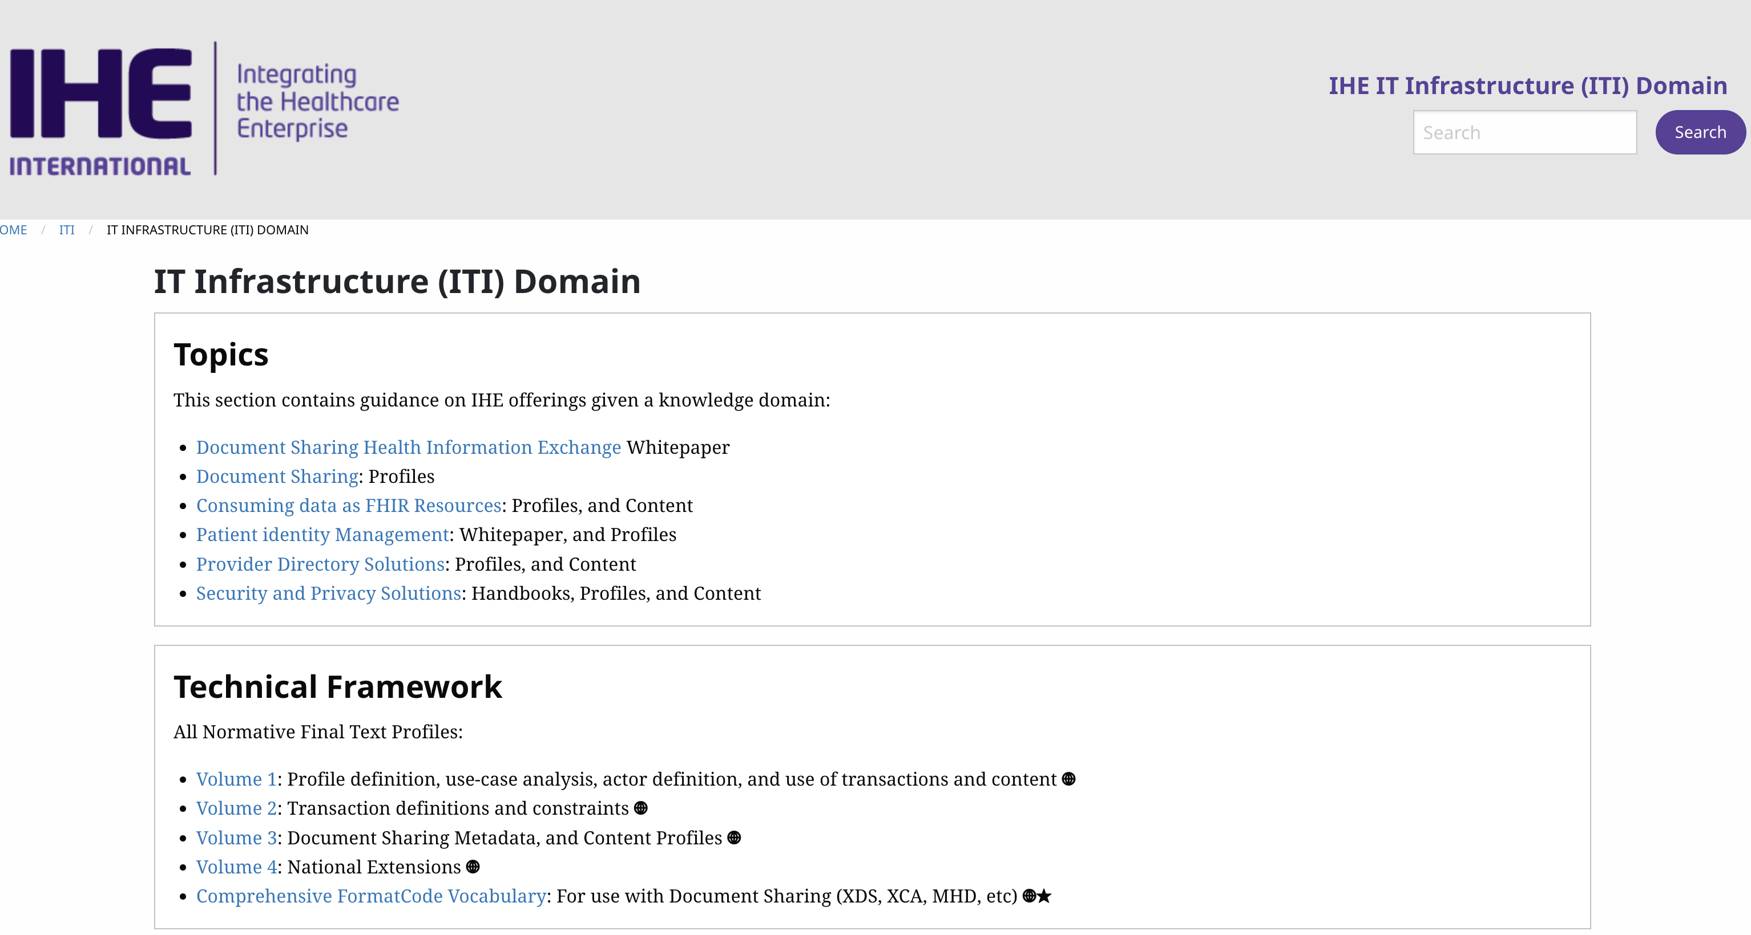
IT-Infrastructure
https://profiles.ihe.net/ITI/

Slide 9
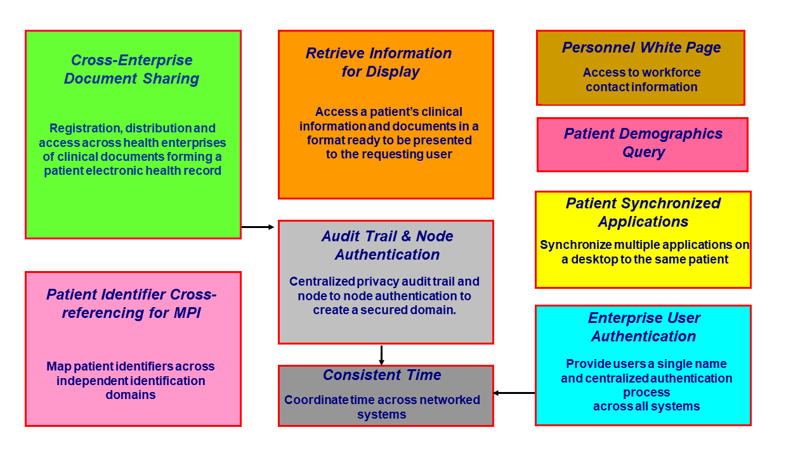
IT-Infrastructure
https://profiles.ihe.net/ITI/TF/Volume1/ch-2.html

Slide 10
ITI – Most significant profiles
Consistent Time (CT)
Audit Trail and Node Authentication (ATNA)
Cross-Enterprise Clinical Documents Share (XDS.b)
Mobile access to Health Documents (MHD)

Slide 11
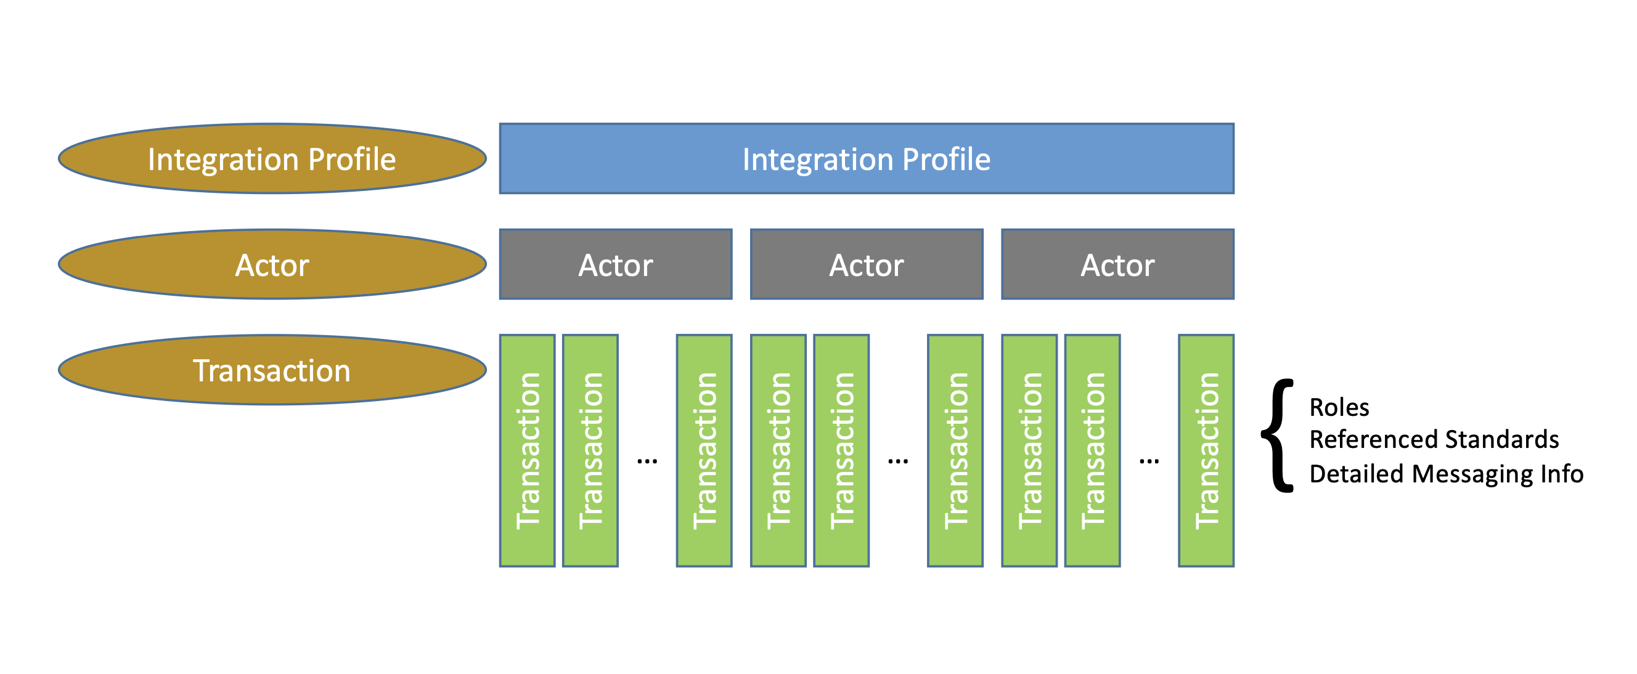
IT-Infrastructure
https://www.ihe.net/about_ihe/faq/#What_is_the_IHE_Technical_Framework?

Slide 12
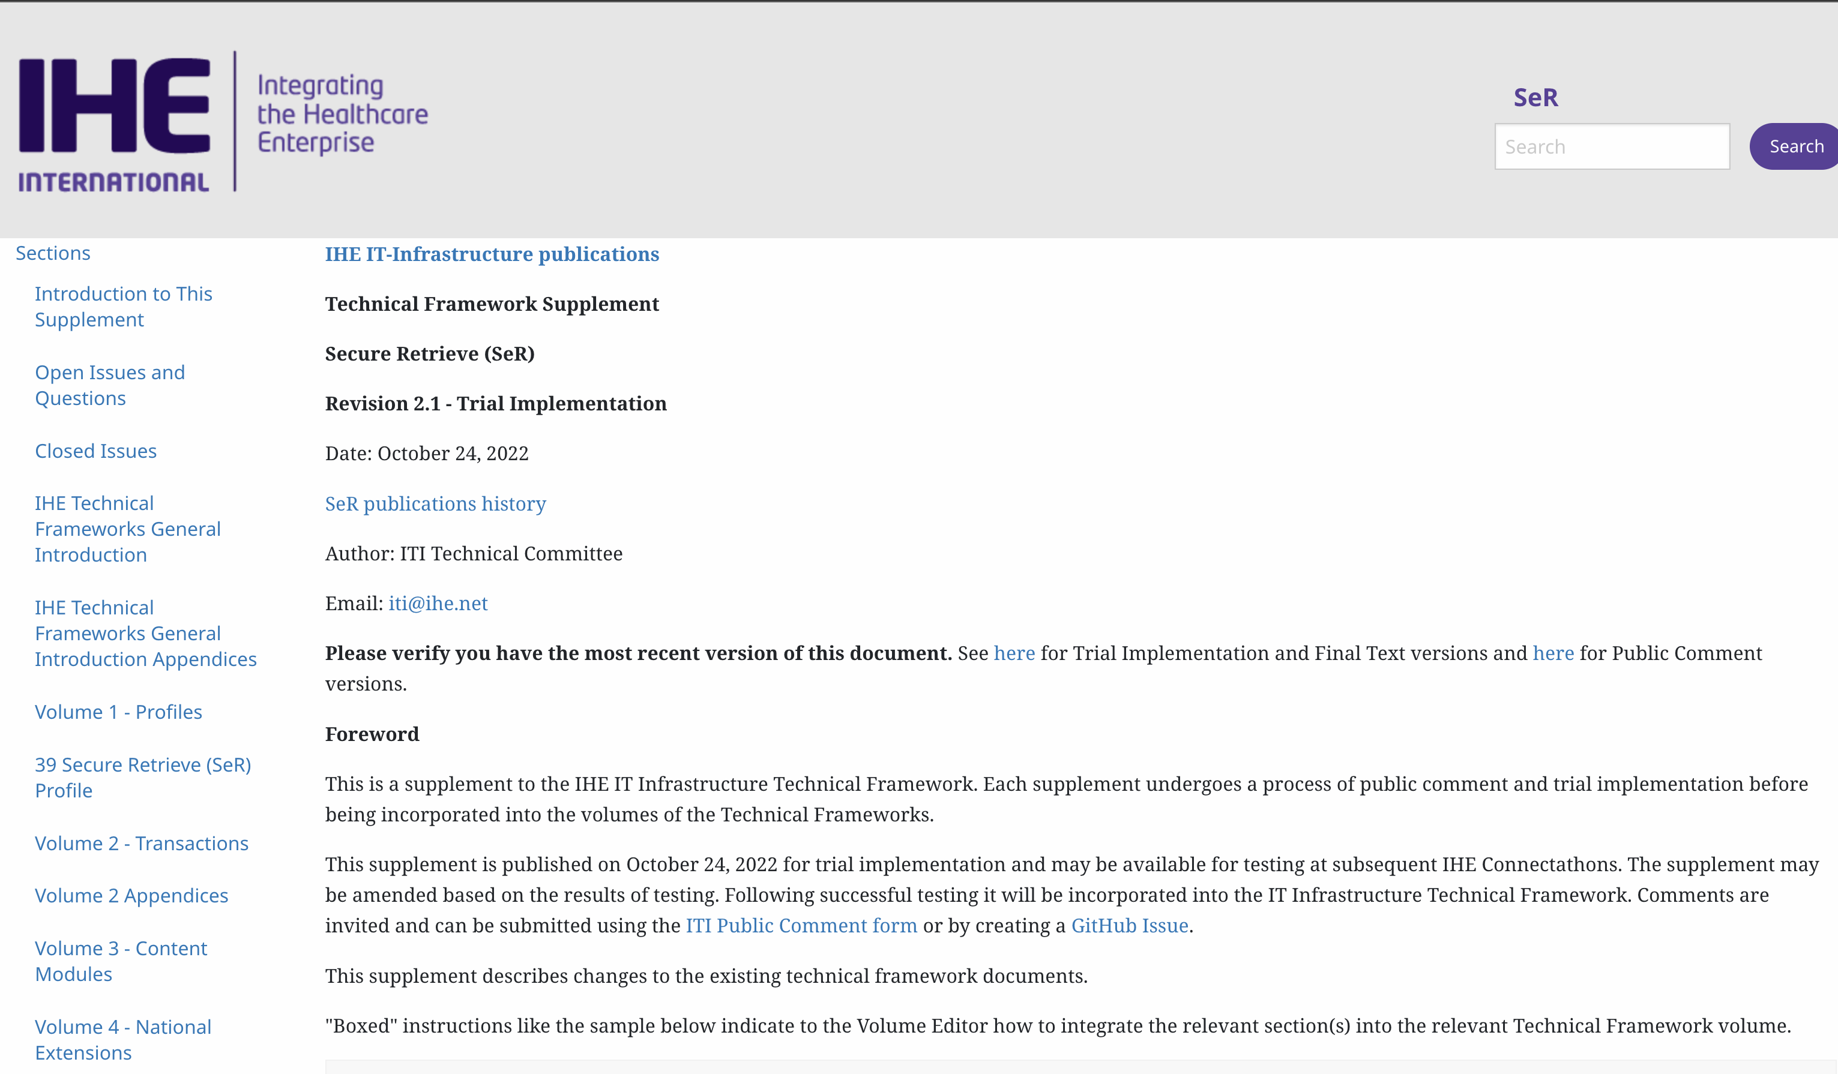
Secure Retrieve (SeR)
https://profiles.ihe.net/ITI/SeR/index.html

Slide 13
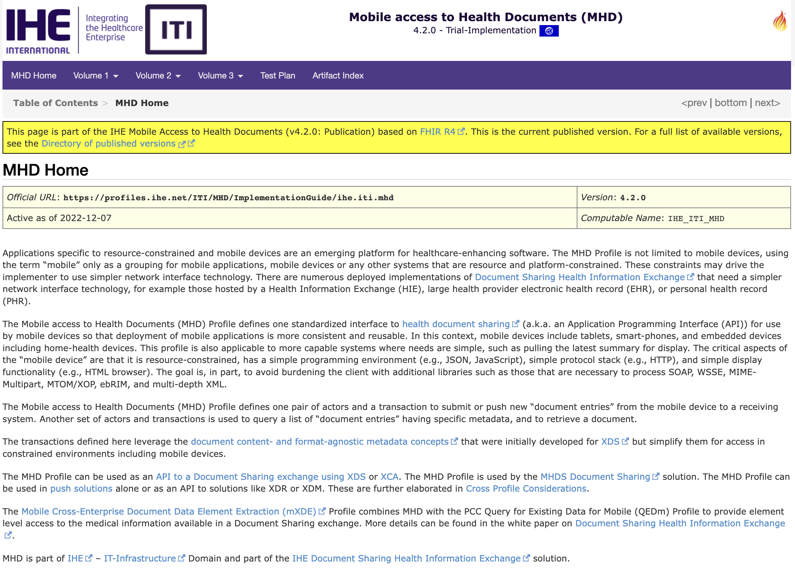
Mobile access to Health Documents (MHD)
https://profiles.ihe.net/ITI/MHD/index.html

Slide 14
IHE Profile Development Process
Allmost all IHE «mobile» Profiles are now published as FHIR Implementation Guides with
Actors, Transactions defined
Conformance Resources (StructureDefinitions, ValueSets, CodeSytems, ConceptMaps, Extensions etc)
and with examples!
Facilitates also testing because Implementation Guides can be used for validation during development.

Slide 15
IHE Profile Development Process
IHE ITI Planning Committee and Technical Committee
Work Item Proposal
Monthly Planning Meeting
Bi-weekly Telcos for Work Items
3 yearly F2F or virtual weekly meeting for work item development
Public Comment Phase
Trial Implementation
https://github.com/IHE/IT-Infrastructure/projects/2

Slide 16
Revised Profiles since last September
Mobile Access to Health Documents (MHD)
Secure Retrieve (SeR)
Basic Audit Log Patterns (BALP)
Sharing Valuesets, Codes, and Maps (SVCM)
https://profiles.ihe.net/ITI/

Slide 17
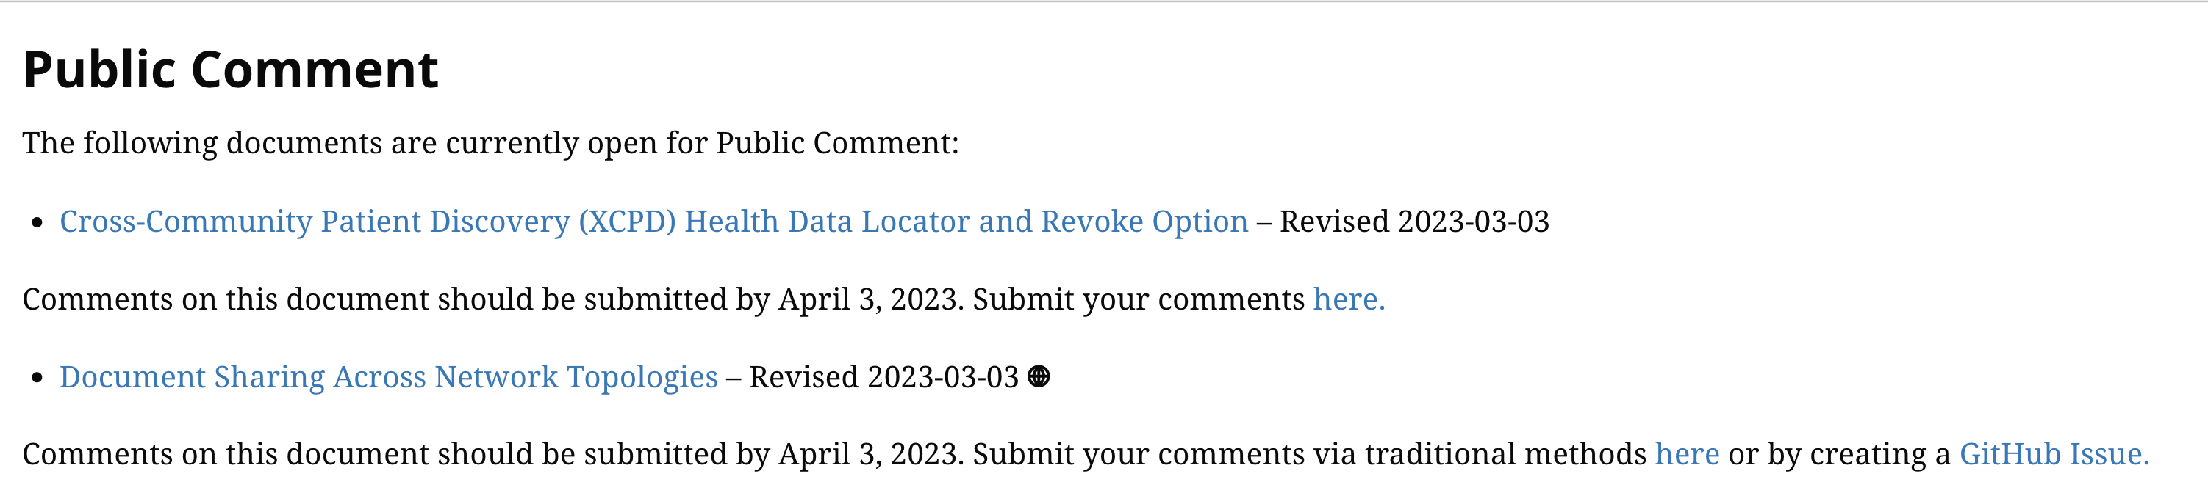
Public Comment till April 3rd
https://profiles.ihe.net/ITI/

Slide 18
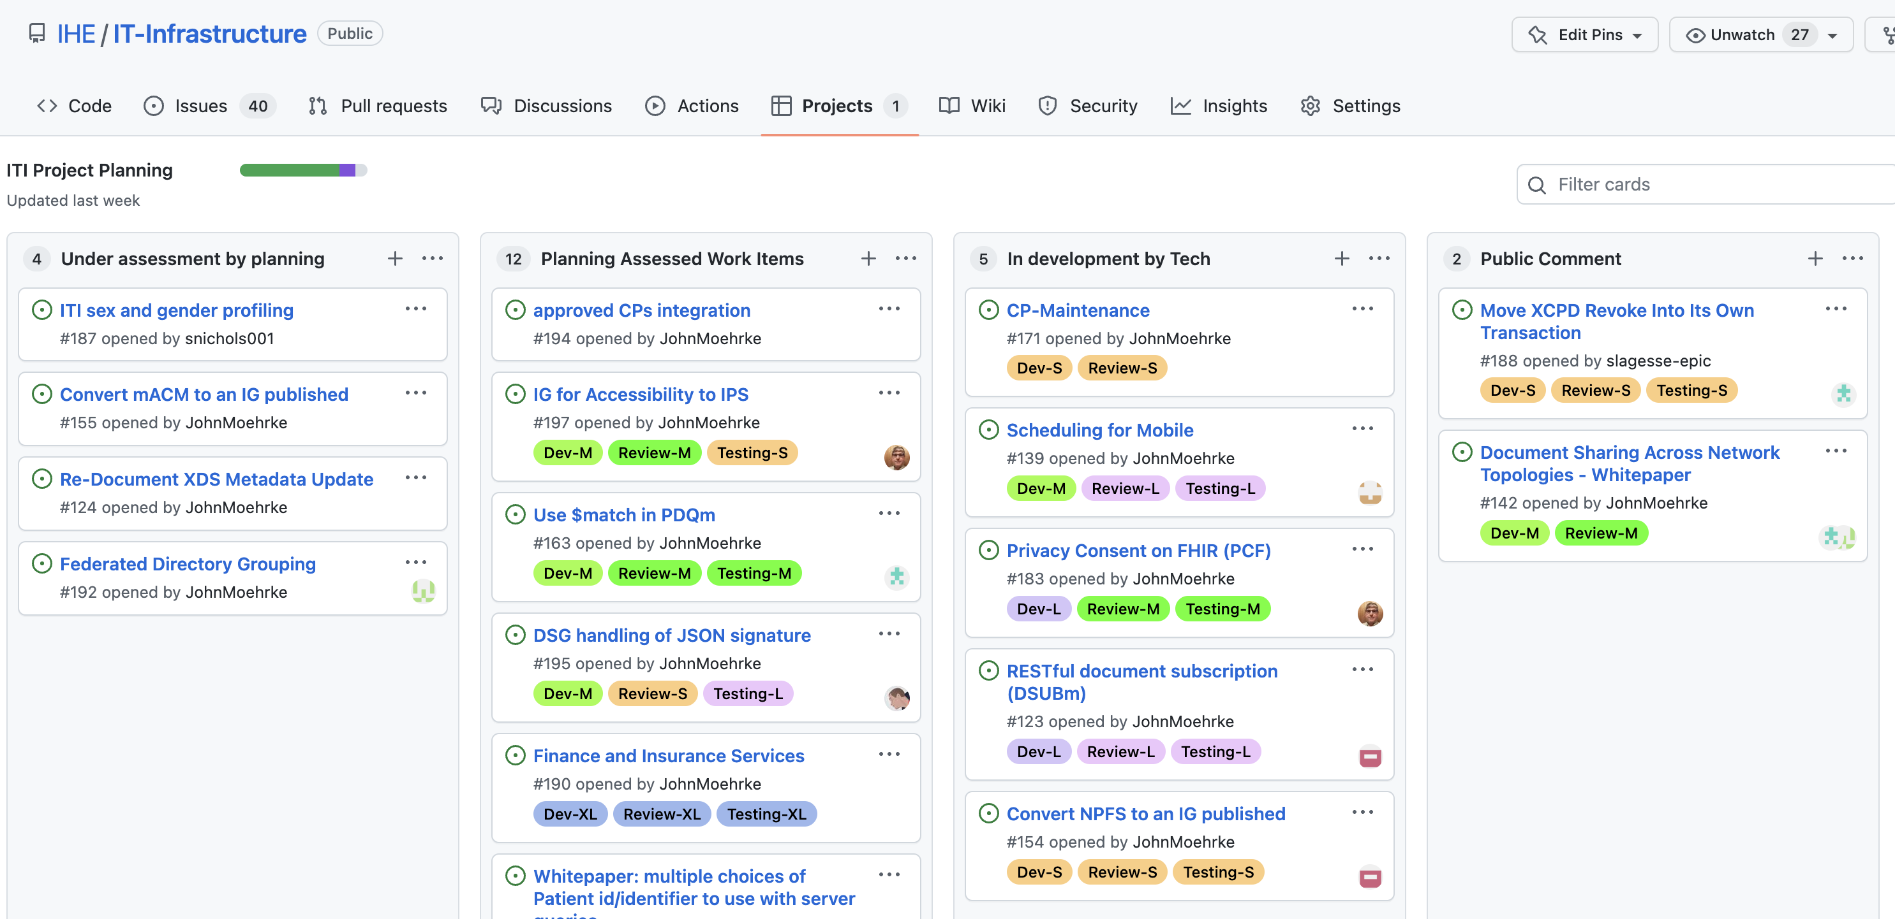
In development
https://github.com/IHE/IT-Infrastructure/projects/2

Slide 19
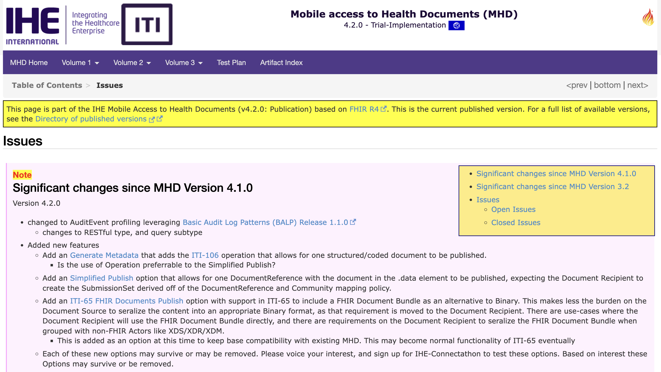
Hot profiles for CAT
https://profiles.ihe.net/ITI/MHD/a_issues.html

Slide 20
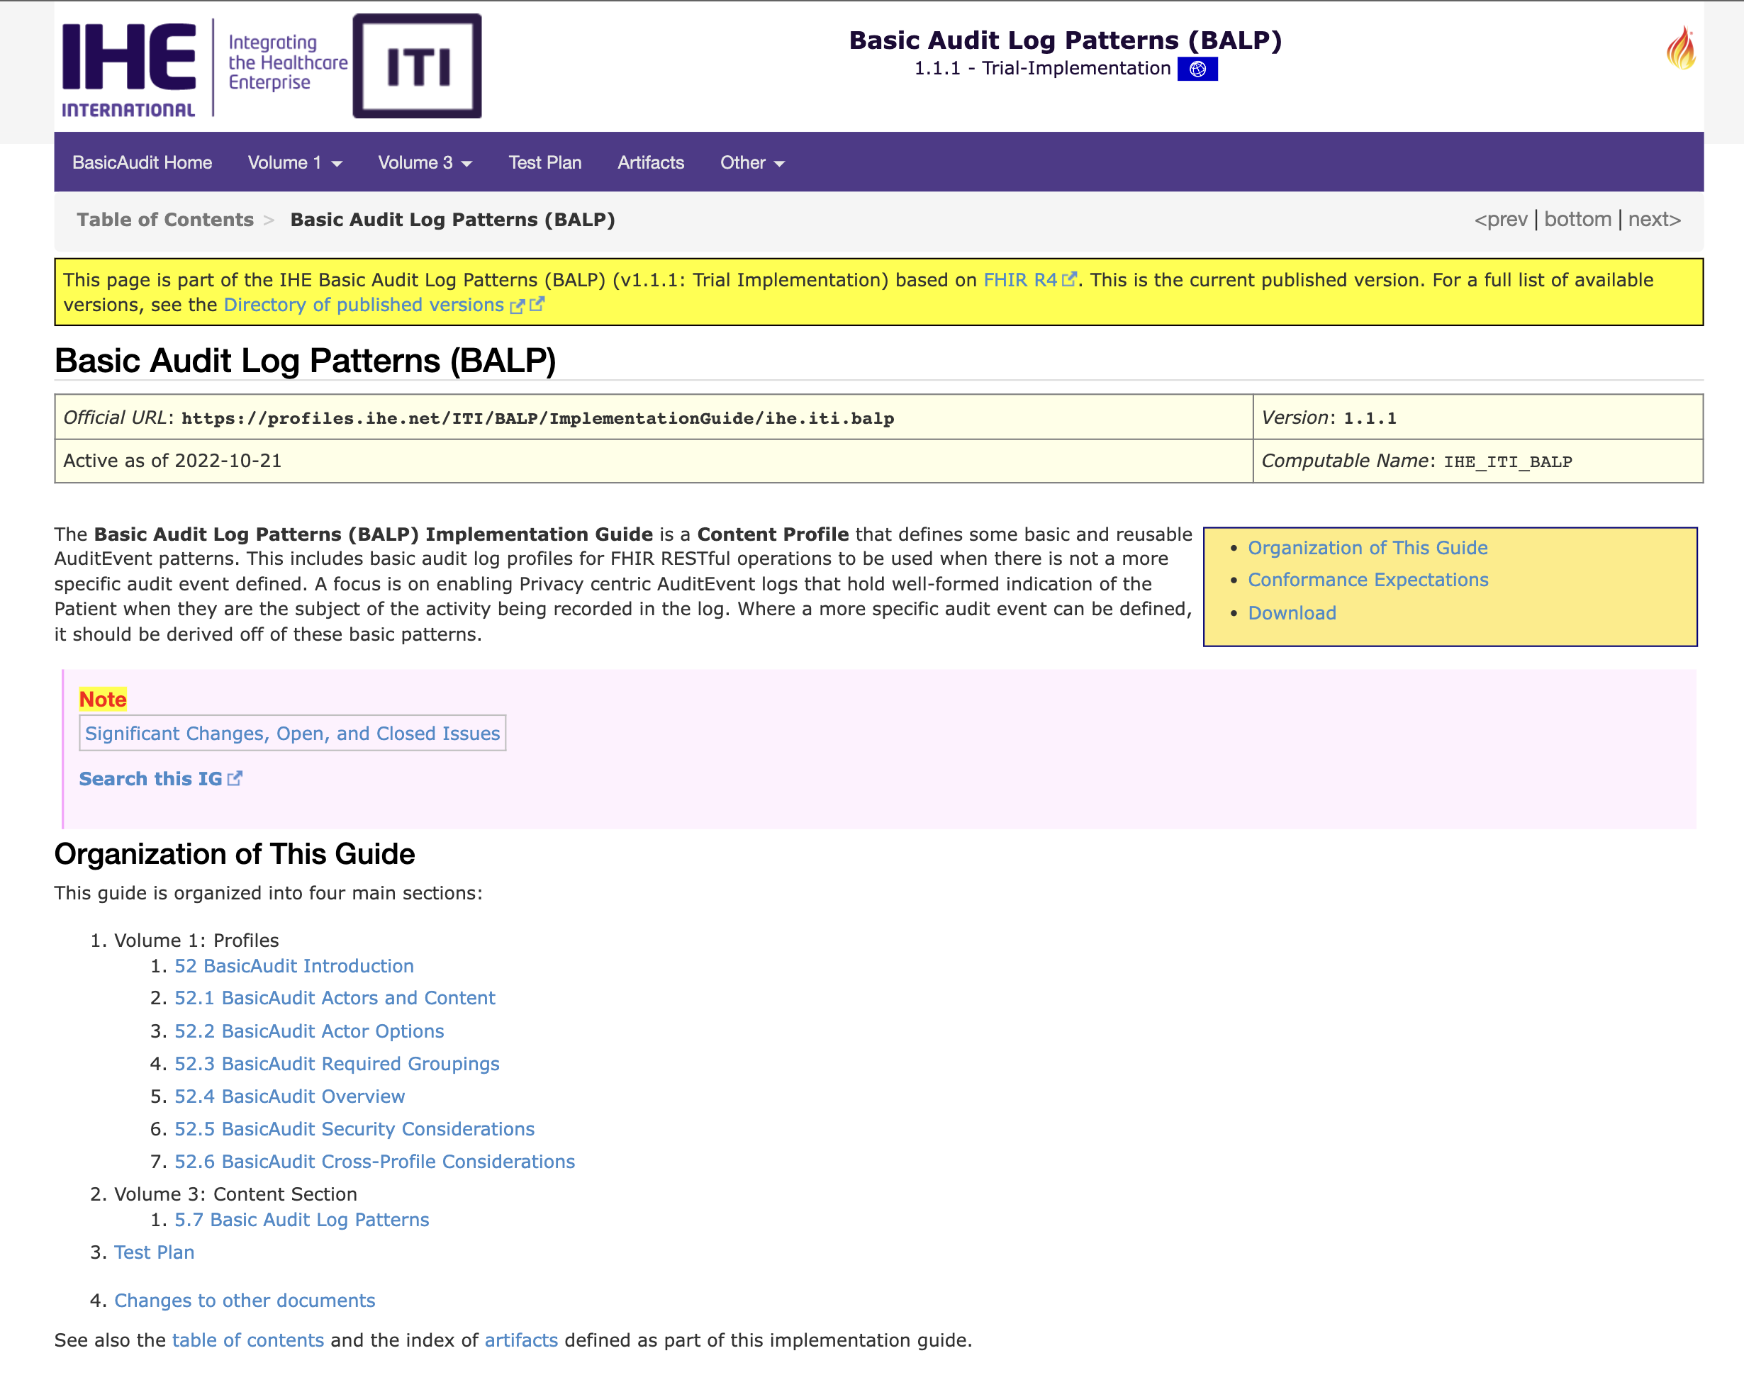
Hot profiles for CAT
https://profiles.ihe.net/ITI/BALP/index.html

Slide 21
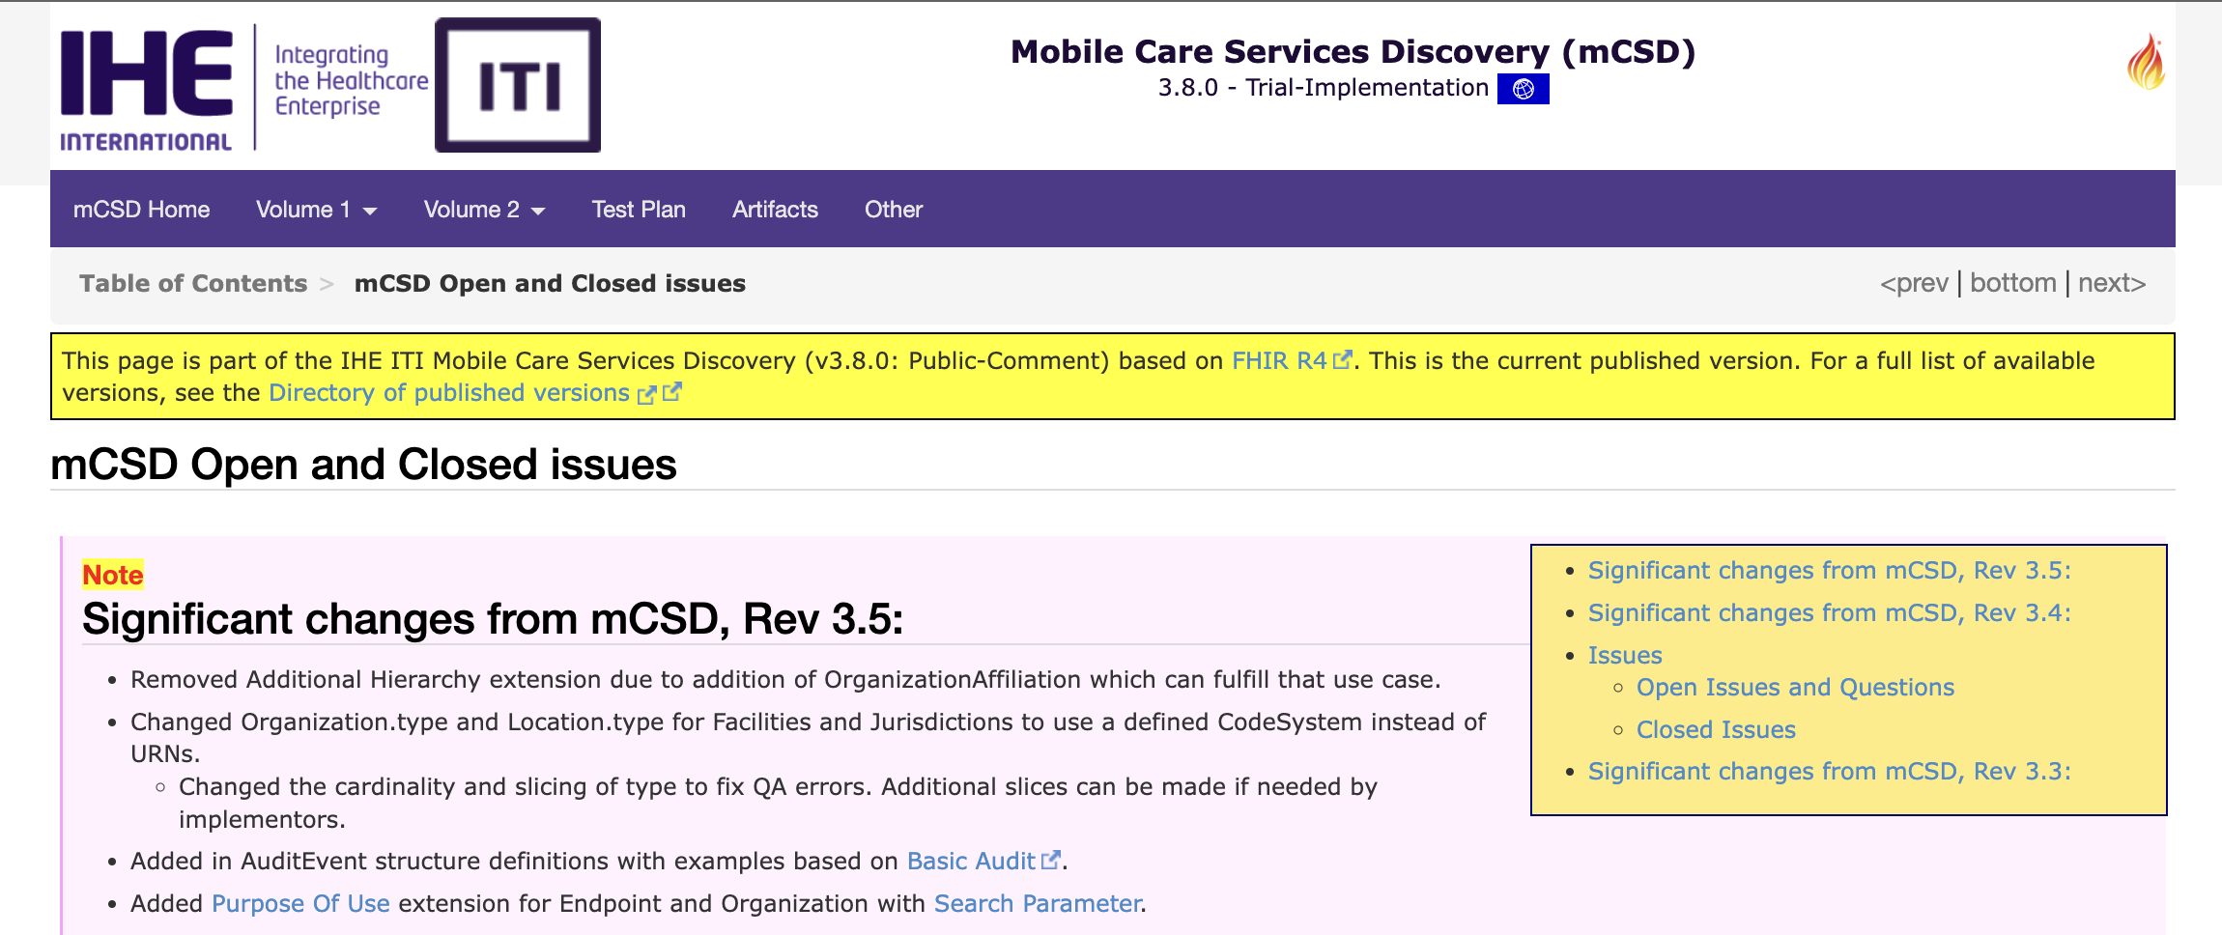
Hot profiles for CAT
https://profiles.ihe.net/ITI/mCSD/issues.html

Slide 22
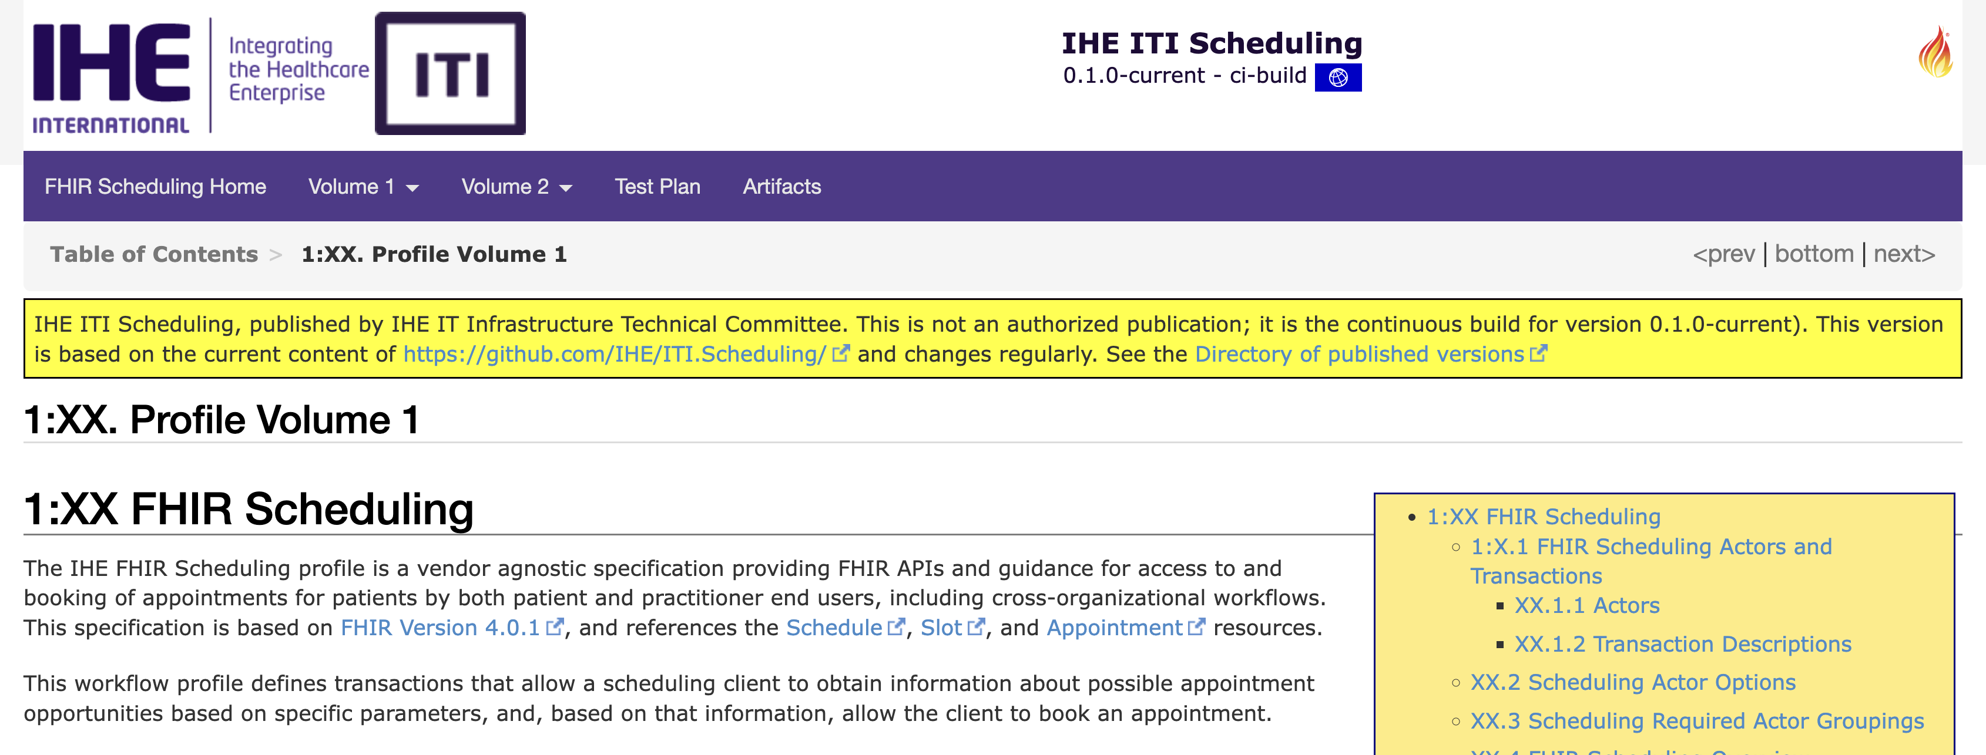
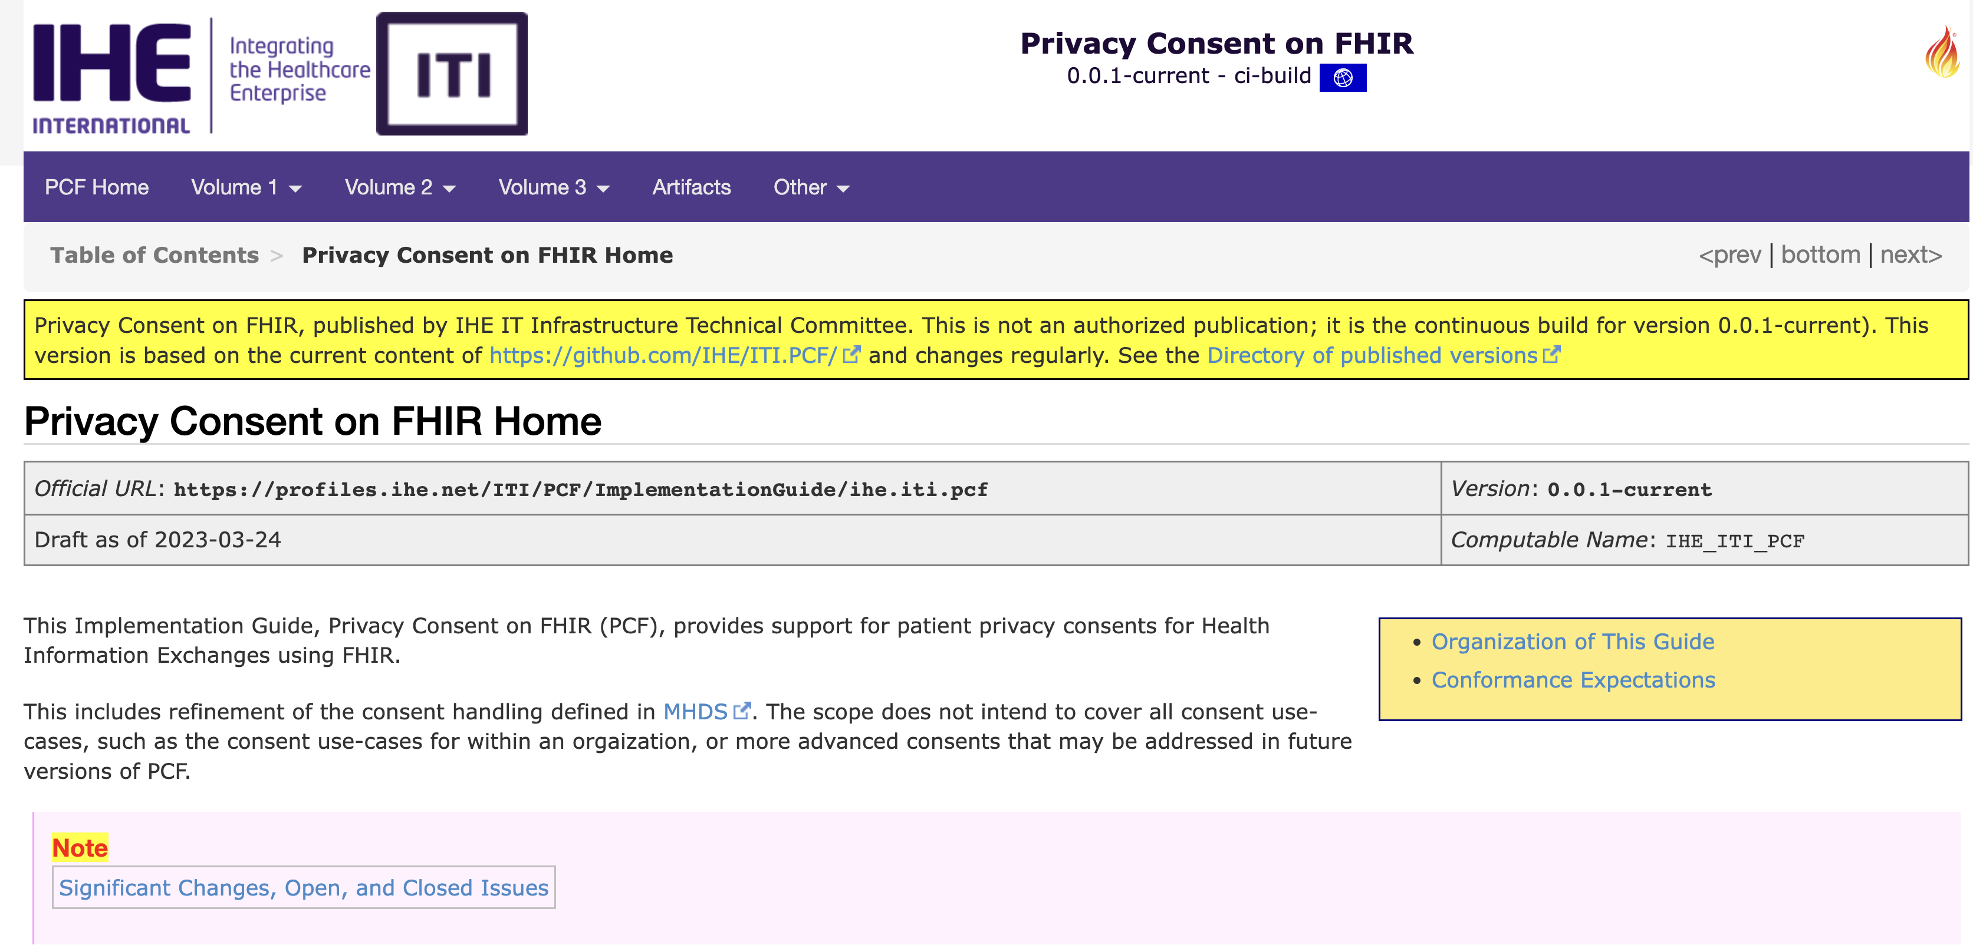
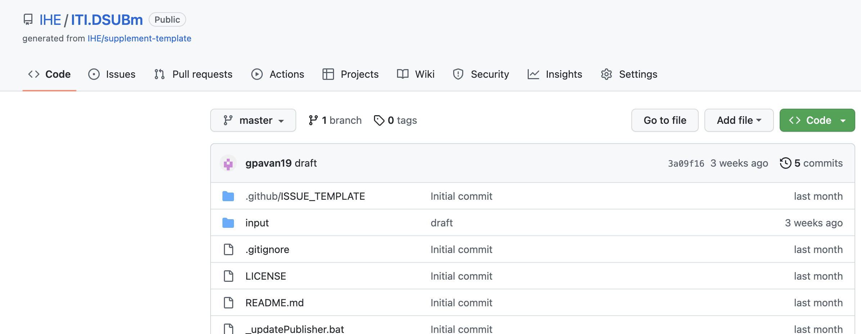
Hot profiles in development
https://build.fhir.org/ig/IHE/ITI.Scheduling/volume-1.html
http://build.fhir.org/ig/IHE/ITI.PCF/branches/master/index.html
https://github.com/IHE/ITI.DSUBm

Slide 23
Q&A

